Slide 1


Lending Club Case Study
By :-
Bhagvan Bux Verma

Slide 2
What is Lending Club Case Study Lending Club is a marketplace for personal loans that matches borrowers who are seeking a loan with investors looking to lend money and make a return.

Slide 3
Abstract
Lending club is the largest online loan marketplace, facilitating personal loans, business loans, and financing of medical procedures.
Borrowers can easily access lower interest rate loans through a fast online interface.
The objective of analysis is to use the information about past loan applicants and find whether they ‘defaulted’ or not.

Slide 4
Problem solving methodology
Data Cleaning
Removing the null valued columns, unnecessary variables and checking the null value percentage and removing the respective rows.
Data Understanding
Working with the Data Dictionary and getting knowledge of all the columns and their domain specific uses
Univariate Analysis
Analysing each column, plotting the distributions of each column.
Segmented Univariate Analysis
Analysing the continuous data columns with respect to the categorical column
Bivariate Analysis
Analysing the two variables behaviour like term and loan status with respect to loan amount..
Recommendations
Analysing all plots and recommendations for reducing the loss of business by detecting columns best which contribute to loan defaulters.

Slide 5
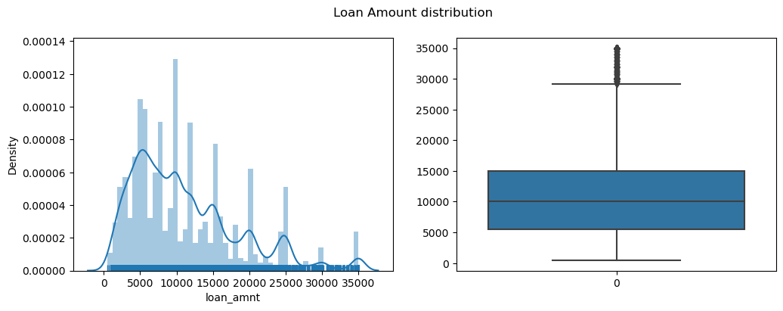
Analysis
Observations: From the above plots, more number of people took loan amount of 10000, and also meadian of distribution is 10000. And very few people took more than 30000 loan amount.

Slide 6

Analysis
Observations: Funded amount data behaves similar to loan Amount, Which tells us that Lending club approved most of Applied loan amount.

Slide 7
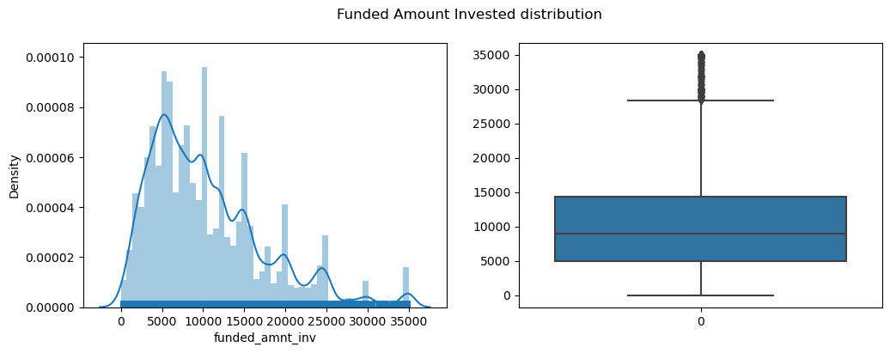
Analysis
Observations: Funded amount investment data behaves similar to loan Amount, Which tells us that Lending club approved atmost of Applied loan amount.

Slide 8
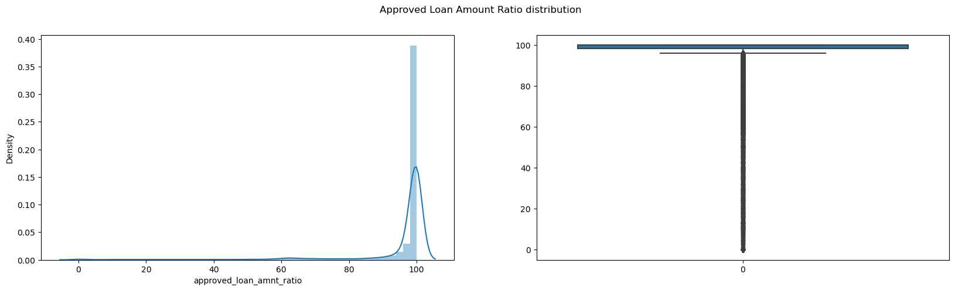
Analysis
Observations: 70% of Borrowers got 100% loan amount from investors.

Slide 9
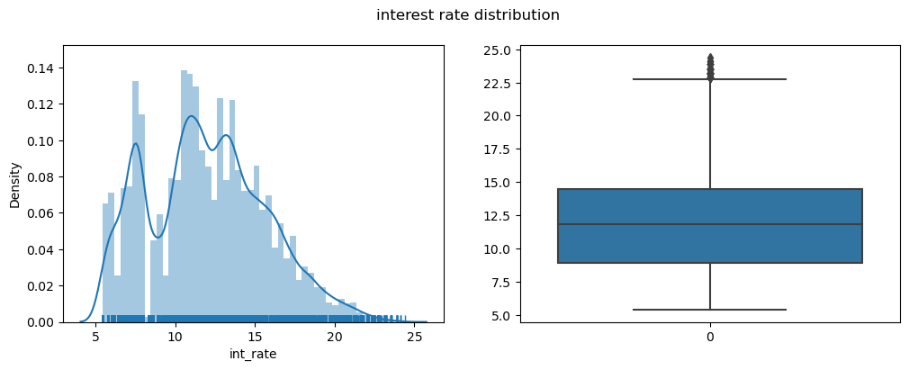
Analysis
Observations: From the above 2 plots and statistics of interest rates we can conclude that most of the interest rates lies between 9% to 14.5%. Some people took loan at higher rates of interest i.e., 22.5%

Slide 10
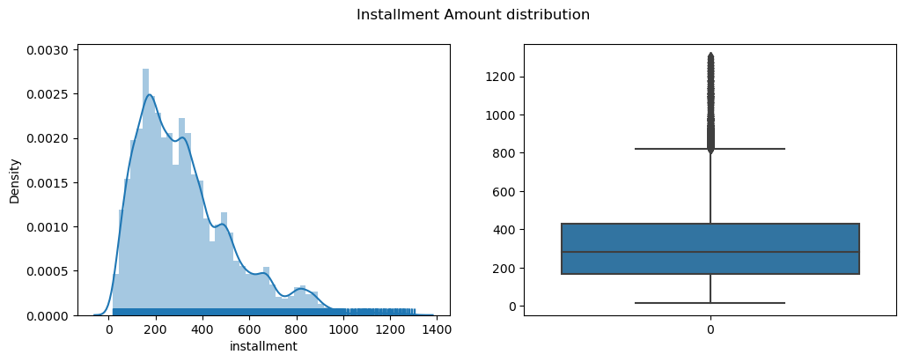
Analysis
Observations: The Most representative value of Installment amount in around 280.

Slide 11
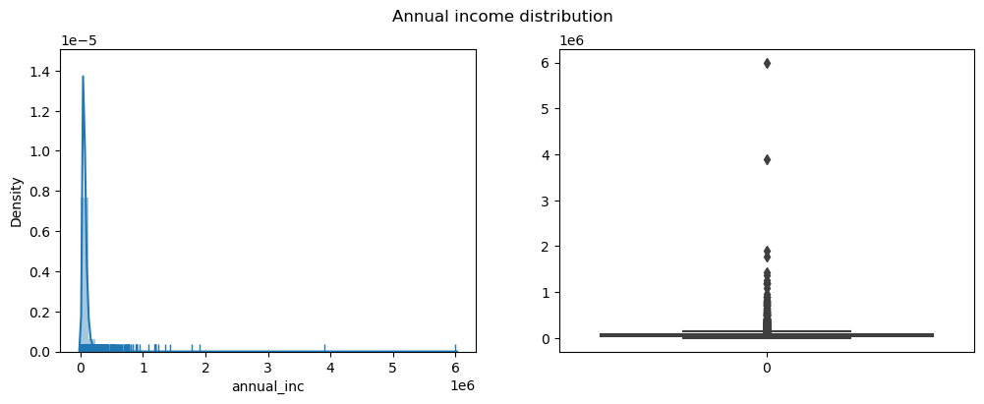
Analysis
Observations: Around 361 people are having more the 235000 annual income. and 99% of people are having incomes below 235000.

Slide 12
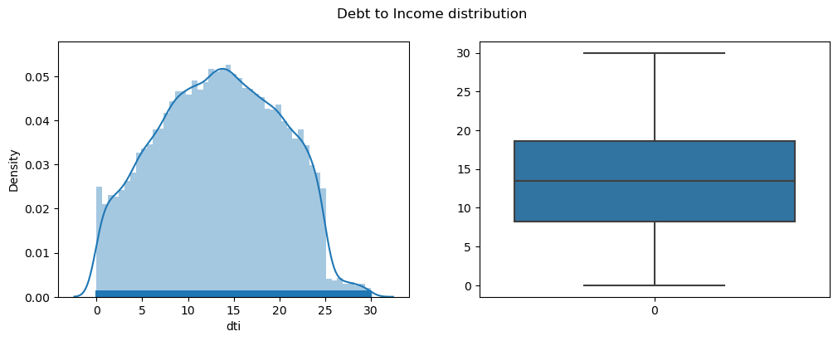
Analysis
Observations: Looks like there are no outliers and the distribution is very much similar to normal distribution. This is good sign that all the loans are given to barrower's who have Debt to Income ration less than 30.

Slide 13
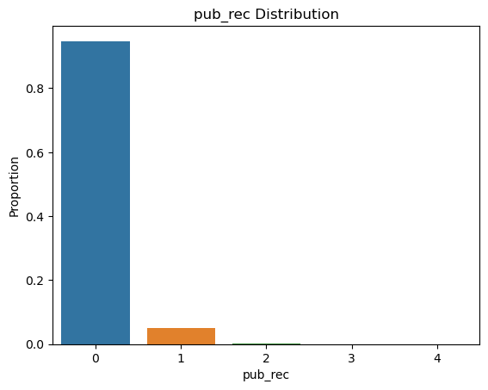
Analysis
Observations: Around 90% borrower's are having no public derogatory records.

Slide 14
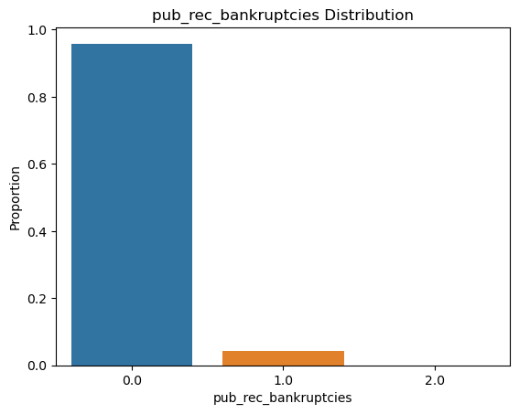
Analysis
Observations: Around 99% people have not went bankrupt..

Slide 15
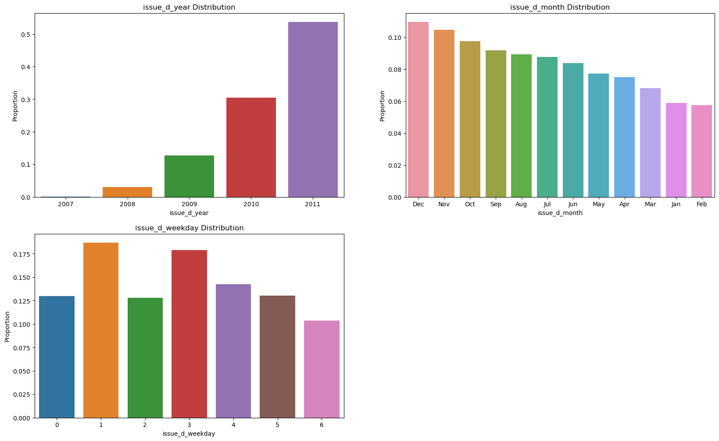
Analysis
Observations: The lending club(LC) has doubling loan issues every year. There are more issues of loan in last 3 months every end of the ear i.e., Oct, Nov and Dec. LC has issued more loans on Tuesday and Wednesday than other week-days.

Slide 16
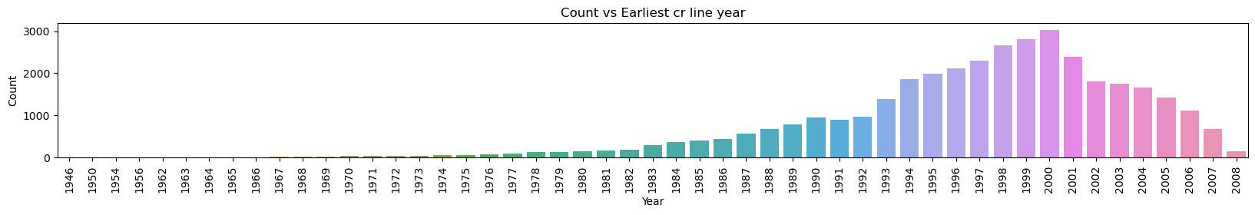
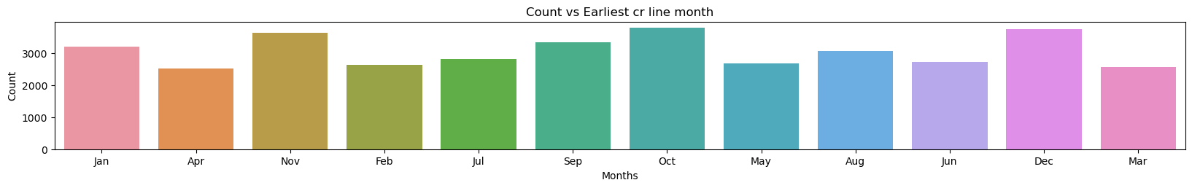
Analysis
Observations: Many of Loan borrowers of LC have got earlier credit line in 2000 year, and also most have got earlier credit line on end of the year i.e., Oct, Nov, Dec

Slide 17
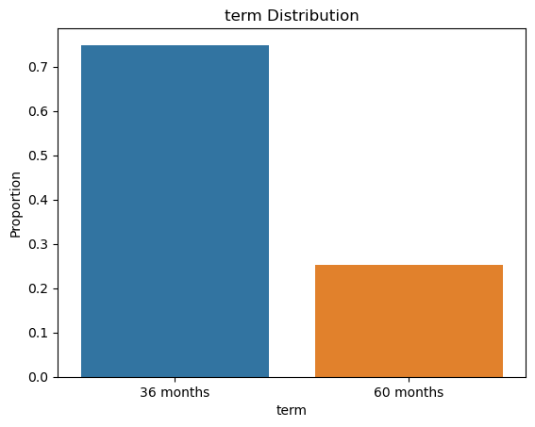
Analysis
Observations: Barrows have taken 36 months tenure more than 60 months.

Slide 18
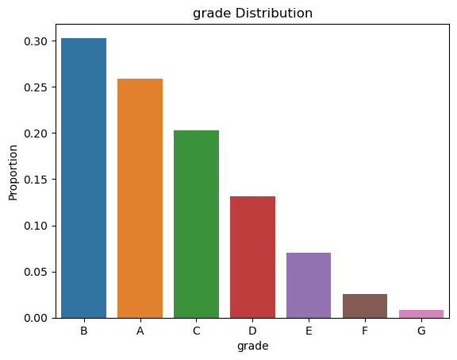
Analysis
Observations: Most borrowers fall under A and B grades then other grades

Slide 19
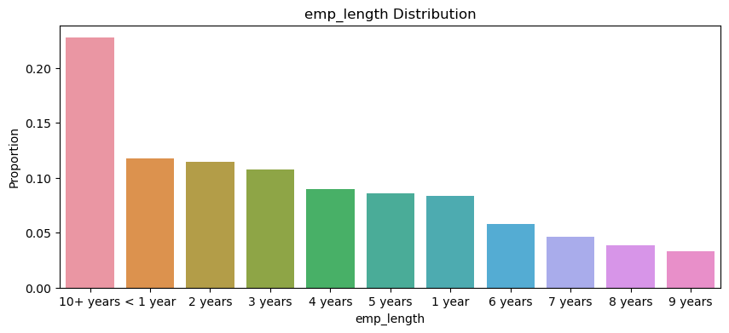
Analysis
Observations: Borrowers are mostly 10+ years employment length.

Slide 20
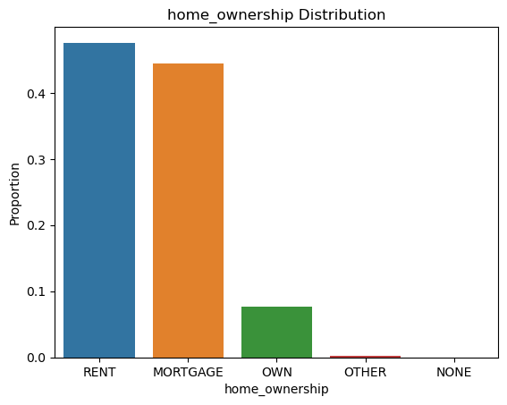
Analysis
Observations: The loan borrowers are mostly having rented and mortgage houses.

Slide 21
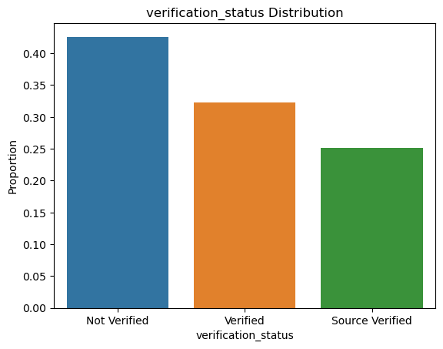
Analysis
Observations: Majority of loans were given without verification of applicants income.

Slide 22
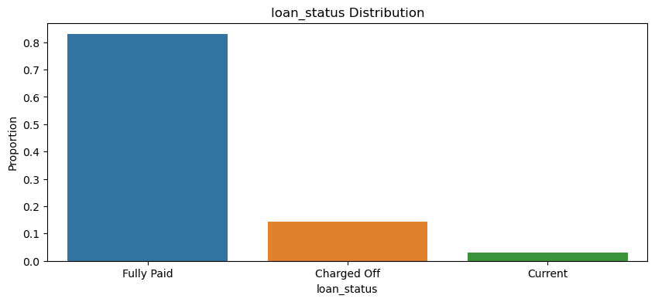
Analysis
Observations: 85% of borrowers has paid the loan fully. where are 14% are defaulted the loan.

Slide 23
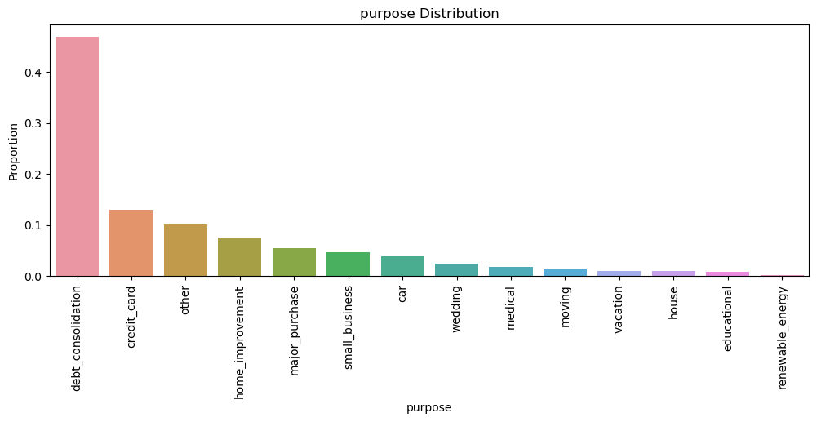
Analysis
Observations: Looks line more number of people took loan for debt consolidation and a very few people took for renewable energy

Slide 24
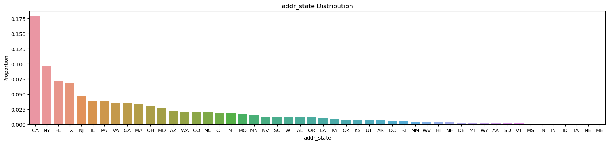
Analysis
Observations: Most of the borrowers are from CA and NY

Slide 25
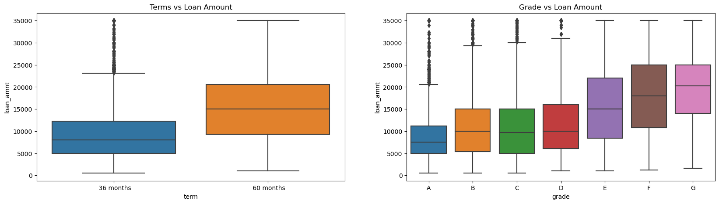
Analysis
Observations: Higher amount loans have high tenure i.e, 60 months. Grade 'G' and 'H' have taken max loan amount. As Grades are decreasing the loan amount is increasing.

Slide 26
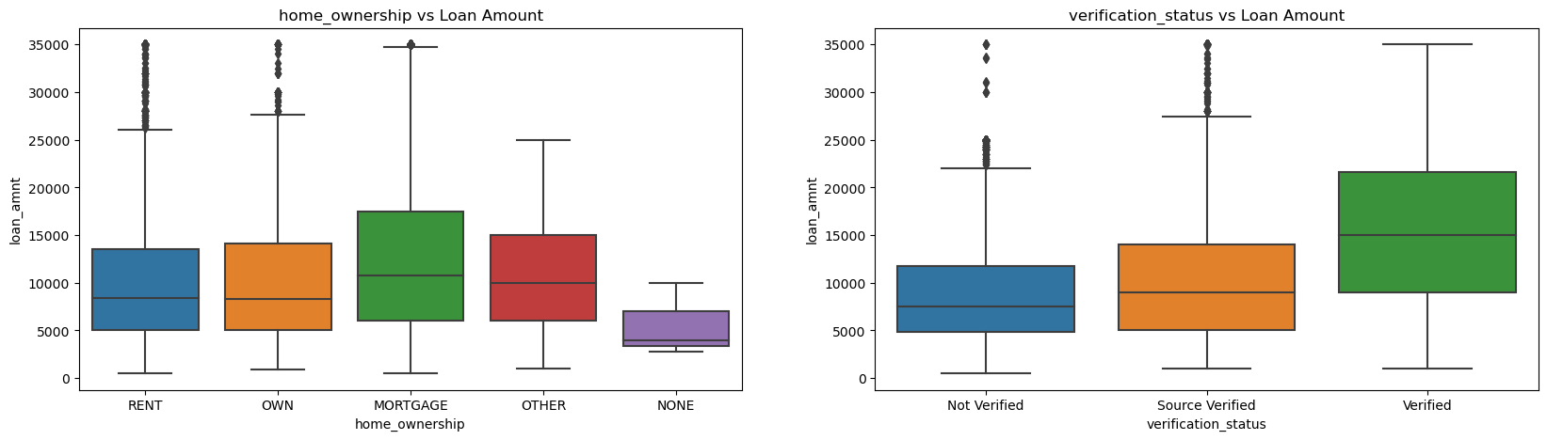
Analysis
Observations: more borrowers are from MORTAGE and also the median loan amount also high for MORTAGE owned borrowers. And most of borrowers are verified for borrowing loan >9k

Slide 27
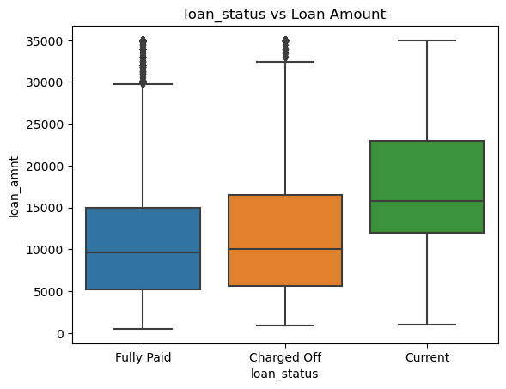
Analysis
Observations: Charged Off loans have higher amounts than Fully Paid ones.

Slide 28
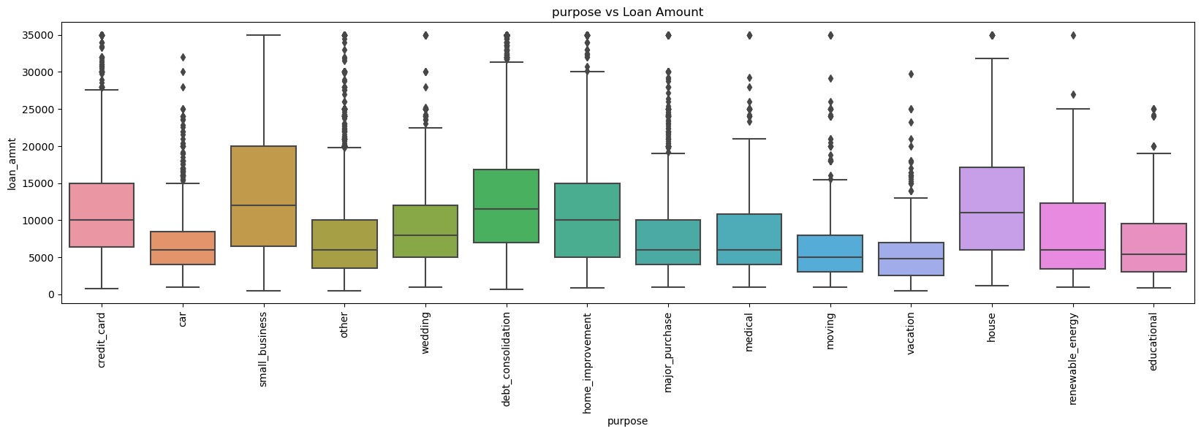
Analysis
Observations: More loan amount is from Small bussiness followed by debt consolidation.

Slide 29
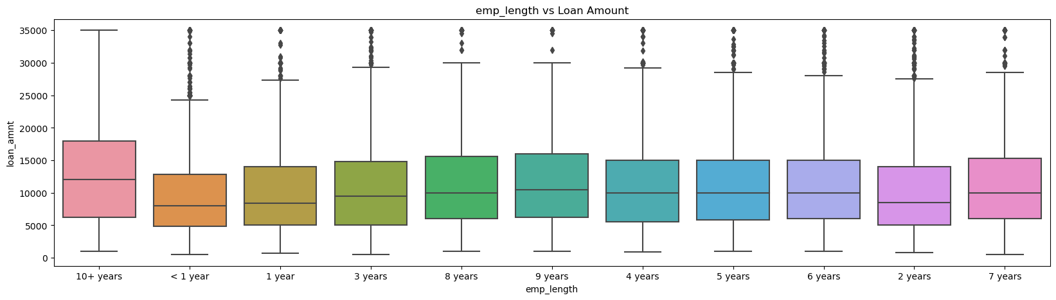
Analysis
Observations: more borrowers are from 10+ years and least is <1 year.

Slide 30
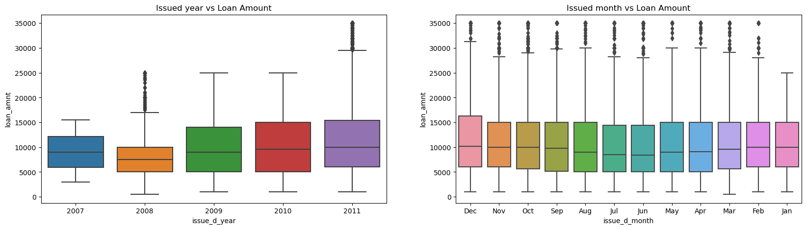
Analysis
Observations:
The meadian loan amount in each year did not change much but the distribution is more spread as the years increase, which means people have taken different loan amounts in each year.
Few Loan borrowers took heigher loan amount in 2008 and 2011 which are plotted as ouliers.
Loan borrowers took almost similar amounts in all the months except in December, people have taken heigher amounts as distribution is high above median.

Slide 31
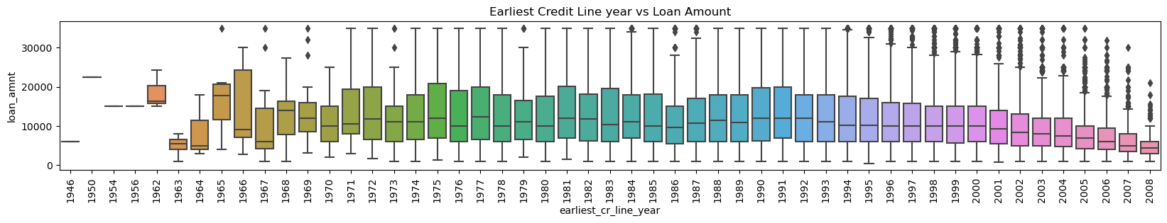
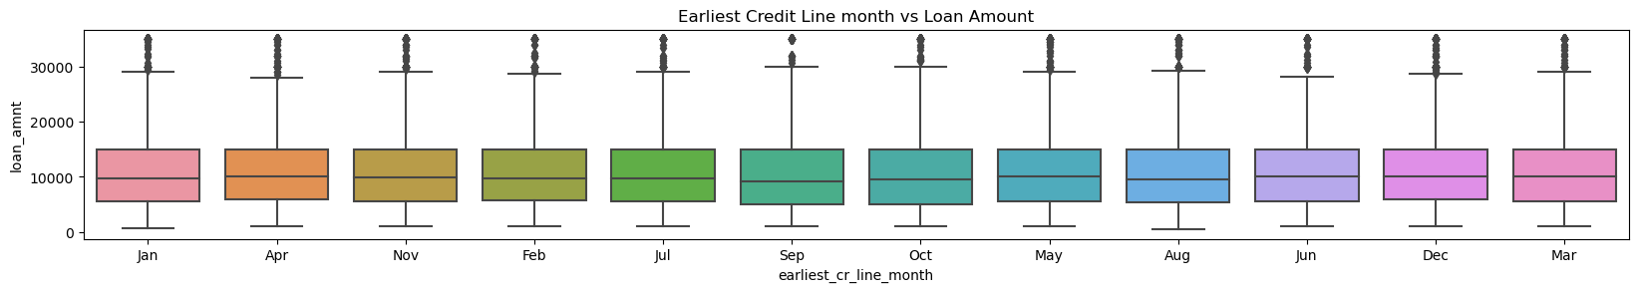
Analysis
Observations:
Borrowers who go earliest credit line in 1966 got wide spreaded amount of loans than others.

Slide 32
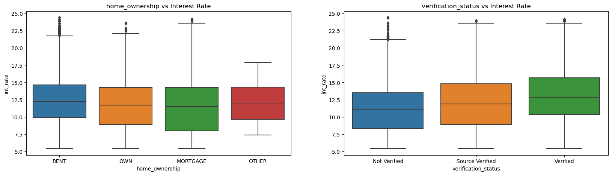
Analysis
Observations:
Barrowers with Own and Mortgage got loans with less interest rates as the security will be there.
And The Non-Verified Barrowers got less interest rates compared to Verified and Source Verified barrowers.

Slide 33
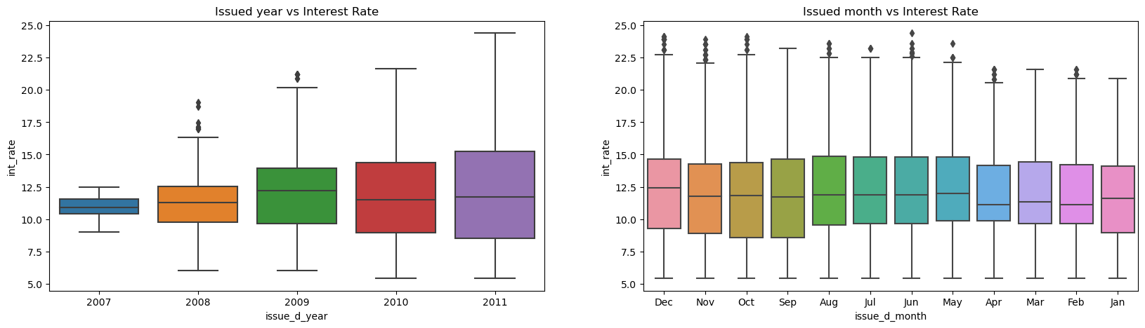
Analysis
Observations:
As the years of business increase the interest rates are getting more diversed but median of of interest rate is quite same in all the years.

Slide 34
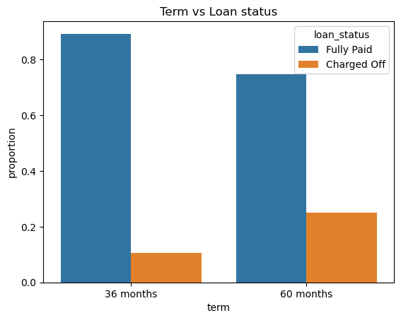
Analysis
Observations:
Looks like there are more proportion of borrowers defaulted loan in 60 months term then 36 months. Also the Fully Paid rate is higher in 36 months tenure.

Slide 35
Conclusions
Lending club should reduce the high interest loans for 60 months tenure, they are prone to loan default.
Grades are good metric for detecting defaulters. Lending club should examine more information from borrowers before issuing loans to Low grade (G to A).
Lending Club should control their number of loan issues to borrowers who are from CA, FL and NY to make profits.
Small business loans are defaulted more. Lending club should stop/reduce issuing the loans to them.
Borrowers with mortgage home ownership are taking higher loans and defaulting the approved loans. Lending club should stop giving loans to this category when loan amount requested is more than 12000.
People with more number of public derogatory records are having more chance of filing a bankruptcy. Lending club should make sure there are no public derogatory records for borrower.

